Slide 1
Utilizing Graph Neural Networks and ML models for personalized AD pathology discovery
Team AD Guys
Hackathon 2022
Mehmet Enes Inam, Karen Bonilla, Karolina Willicott, Pradeep Varathan
(authors in alphabetical order)

Slide 2
Disclosures
Unlabeled/Unapproved Uses Disclosures:
We do not have relevant financial relationships with commercial interests related to the content of this presentation.
Acknowledgement:
We would like to thank the Hackathon committee for organizing this event, and for the opportunity to participate in it.

Slide 3
Index
Introduction
Research Question/Aims
Methods
Deep Learning Model
Machine Learning models (4)
Data Used
Results
Heatmaps
Cytoscape
User interaction (docker and git)
Future goals if possible

Slide 4
Introduction
Alzheimer’s disease (AD) is the most common form of dementia (60-70%) mainly affecting the elderly (age >65) with an estimated annual cost of about $300 billion USD (“2020 Alzheimer’s Disease Facts and Figures,” 2020; Dementia, n.d.; Winston Wong, 2020).
There is no cure for AD, and in the past twenty years only two drugs (Aducanumab and Gantenerumab) have had a potential to show clinically meaningful results (Commissioner, 2021; Gantenerumab | ALZFORUM, n.d.; How Is Alzheimer’s Disease Treated?, n.d.; Ostrowitzki et al., 2017; Tolar et al., 2020).
Exploration of additional biomarkers for this complex disease is, therefore, warranted and could potentially aid in the early detection or therapeutic intervention of AD patients.

Slide 5
Methods
We wish to develop a multiplex machine learning (ML) approach to identify [gene]omics biomarkers in AD and mild cognitive impairment (MCI) compared to healthy controls (HC).
Identify best ML model that predicts AD or MCI versus HC
Apply this model on a validation set to confirm the performance
Combine multiple (RNA-seq and miRNA) datasets to see if model performance improves
We will utilize the following ML [clustering] tools:
Lasso Logistic Regression
Random Forest
Graph Convolutional Networks

Slide 6
Methods - Dataset Used
PPI – HPRD PPI network which is filtered for the largest connected component made of 5355 genes​
Expression data – Pre-processed ROSMAP Expression data with 236 subjects, filtered with the 5355 genes obtained from HPRD PPI​
Filtered down to only 236 subjects with 5355 gene probes. The number of subjects were filtered to obtain the maximum number of subjects with all the expression data while the number of gene​ probes were chosen from the HPRD PPI network genes. ​
The subjects chosen were also between control and AD disease subjects with 141 controls and 95 subjects.​

Slide 7
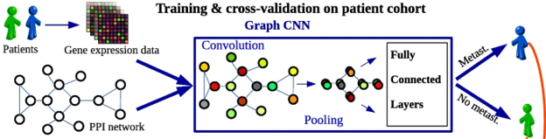
Methods - Graph Convolutional Networks (GNN)
GNNs are the generalized version of CNNs where the numbers of nodes connections vary, and the nodes are unordered.​
Input is unordered in structure and considers the neighboring relations​
Graph CNN captures information from the network topology for prediction process ​
Especially in genetic data, the observed and proven network could help refine important pathways that could help in prediction ​
A layer wise propagation algorithm tailored for Graph-CNN​
Using the Laplacian function and spectral graph theory, computes its Taylor decomposition to find the relative weights for the nodes present in the graph​
Attempts to decode the black box problem​

Slide 8


Results - Lasso Logistic Regression & Random Forest (RF)
Tuned Parameter (Lasso):
C: 1 -> 100
Future Parameter Tuning Changes (RF):
Random States 1 -> 4
Number of Estimators -> 463

Slide 9
Results - Graph Neural Network
Two convolutional layers with 16 filters each and one hidden​ layer with 128 nodes​
Pooling was done over a filter of size 2x2, with a batch size of​ 100​
The final metrics for the architecture were​
AUC 76.588%​ F1-weighted 76.978%​ Test accuracy 79.167% ​

Slide 10
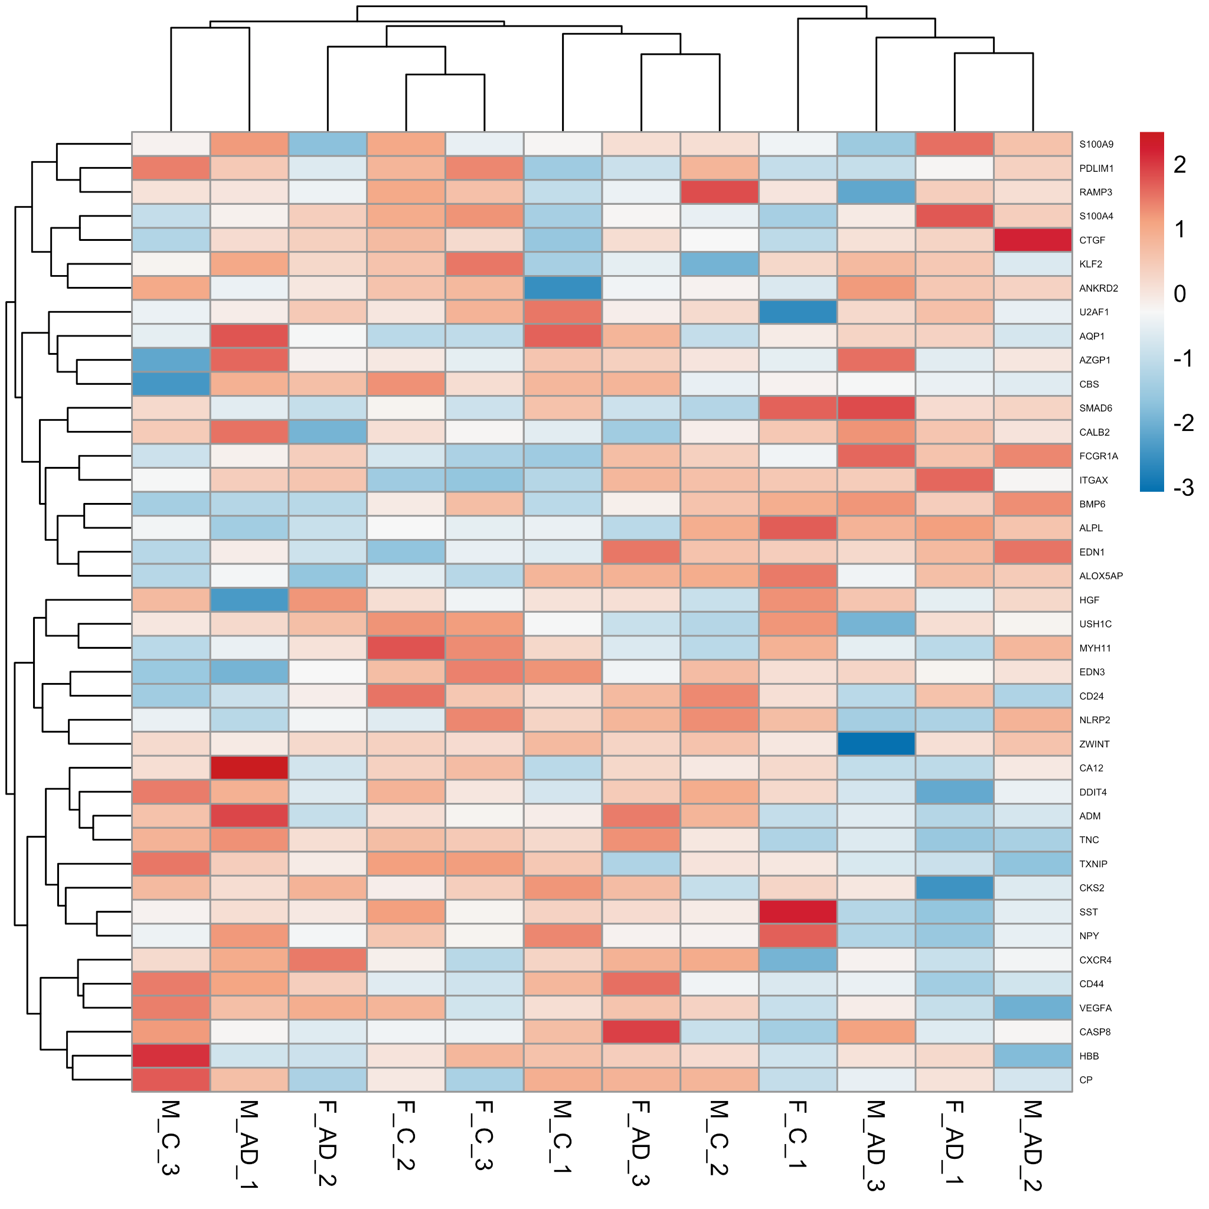
Results - All Genes from ROSMAP
The heatmap for three randomly picked patients:
AD vs HC
Male vs Female

Slide 11
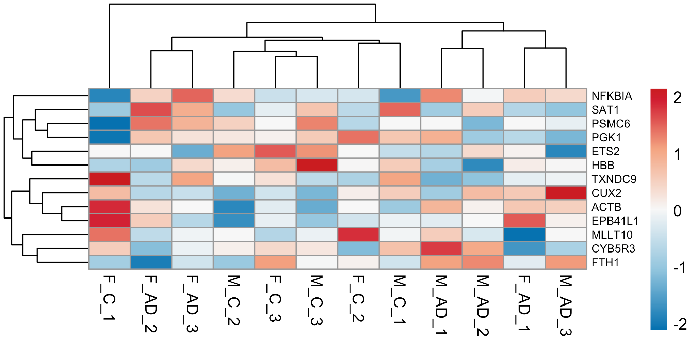
Results - Top 10 from ROSMAP
The heatmap for three randomly picked patients:
AD vs C
Male vs Female

Slide 12
Results - Demographic Data & APOE from ROSMAP
Females - AD
APOE 4/4 - I
APOE 3/4 - III
APOE 3/3 - I
APOE 2/3 - 0
Females - Control
APOE 4/4 - 0
APOE 3/4 - I
APOE 3/3 - IIII IIII
APOE 2/3 - I
Males - AD
APOE 4/4 - 0
APOE 3/4 - IIII I
APOE 3/3 - IIII II
APOE 2/3 - I
Males - Control
APOE 4/4 - 0
APOE 3/4 - III
APOE 3/3 - IIII IIII IIII III
APOE 2/3 - I

Slide 13
Results - Literature Review of Top 10 Genes from ROSMAP
ETS2: ETS Proto-Oncogene 2, Transcription Factor Sumarsono et al., 1996
CUX2: Cut Like Homeobox 2 Jorge et al., 2021
HBB: Hemoglobin Subunit Beta Perry et al., 2008
FTH1: Ferritin Heavy Chain 1 Milward et al., 2010
MLLT10: Histone Lysine Methyltransferase DOT1L Cofactor Moshkanbaryans et al., 2014
SAT1: Spermidine/Spermine N1-Acetyltransferase 1 Mahajan et al., 2020
CYB5R3: Cytochrome B5 Reductase 3 Zhang et al., 2018
PSMC6: Proteasome 26S Subunit, ATPase 6 Neff et al., 2021
EPB41L1: Erythrocyte Membrane Protein Band 4.1 Like 1 Bendl et al., 2021
PGK1: Phosphoglycerate Kinase 1 Isoda et al., 2010
ACTB: Actin Beta Talwar et al., 2014
TXNDC9: Thioredoxin Domain Containing 9 Zheng et al., 2020
NFKBIA: NFKB Inhibitor Alpha Jamal et al., 2016

Slide 14
Results - Top 10 from GSE63063
*Gene found in Literature*
MCI and AD
Negative
HLA-C*
LOC642178
CLC
C16ORF35
CYP27A1*
IFITM3*
LOC388588
C17ORF97
C21ORF81
IRF5*
MCI vs Control
Negative
CCDC23
FOLR3
HBZ
LY86
H1F0
GCAT
LOC653820
RAP1GAP
RPS23
TUBB2A
Positive
FAM21A
LOC388588
MYOM2
CLEC12A
HMBOX1
RNASE2
LPCAT2
CA1
FAR2
NBPF10
AD vs Control
Negative
LOC653658
MMP9
RPL36AL
PPDPF
ZHX2
GPR162
IFITM3
HLA-DOB
CLC
FCER2
Positive
S100P*
HS.535044
SNORD13
IL18RAP
HDC
TREML3*
SNORD8
SLC26A8
LOC653820
VAMP5*
Positive
ATHL1
SNHG5
HLA-H
IKZF3
TPST1
STAT6
MT1E
ASAP1
SIGLEC14
S100P

Slide 15
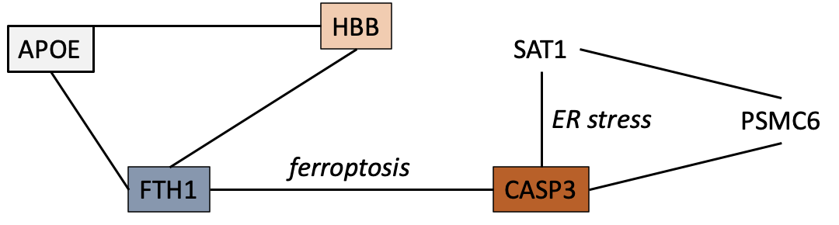
Conclusion
Dysfunctional hemoglobin (HBB gene) induced iron deregulation potentially plays a role in the elevation of intracellular toxicity, reactive oxygen species, (involving SAT1 and PSMC6 genes) leading to the activation of associated apoptotic pathways (Ferroptosis involving FTH1, SAT1, and CASP8 genes) in AD.
Insulin resistance in AD, previously defined in the literature (Altunoğlu et al., 2014; Femminella et al., 2021; Ferreira et al., 2018), might tie into this hypothetical pathophysiology while other inflammatory pathways may be explained as a consequential immune response focusing our attention to upstream pathways of microglial activation for more of causal biomarkers.
Future studies should validate our findings. Further exploration of both upstream and downstream pathways of the immunologic activities may be good targets for early detection or treatment of AD.

Slide 16
References
2020 Alzheimer’s disease facts and figures. (2020). Alzheimer’s & Dementia, 16(3), 391–460. https://doi.org/10.1002/alz.12068
Altunoğlu, E., Müderrisoğlu, C., Erdenen, F., Ülgen, E., & Ar, M. C. (2014). The Impact of Obesity and Insulin Resistance on Iron and Red Blood Cell Parameters: A Single Center, Cross-Sectional Study. Turkish Journal of Hematology, 31(1), 61–67. https://doi.org/10.4274/Tjh.2012.0187
Commissioner, O. of the. (2021, June 7). FDA Grants Accelerated Approval for Alzheimer’s Drug. FDA; FDA. https://www.fda.gov/news-events/press-announcements/fda-grants-accelerated-approval-alzheimers-drug
Dementia. (n.d.). World Health Organization. Retrieved April 18, 2022, from https://www.who.int/news-room/fact-sheets/detail/dementia
Femminella, G. D., Livingston, N. R., Raza, S., van der Doef, T., Frangou, E., Love, S., Busza, G., Calsolaro, V., Carver, S., Holmes, C., Ritchie, C. W., Lawrence, R. M., McFarlane, B., Tadros, G., Ridha, B. H., Bannister, C., Walker, Z., Archer, H., Coulthard, E., … Edison, P. (2021). Does insulin resistance influence neurodegeneration in non-diabetic Alzheimer’s subjects? Alzheimer’s Research & Therapy, 13(1), 47. https://doi.org/10.1186/s13195-021-00784-w
Ferreira, L. S. S., Fernandes, C. S., Vieira, M. N. N., & De Felice, F. G. (2018). Insulin Resistance in Alzheimer’s Disease. Frontiers in Neuroscience, 12, 830. https://doi.org/10.3389/fnins.2018.00830
Gantenerumab | ALZFORUM. (n.d.). Retrieved April 18, 2022, from https://www.alzforum.org/therapeutics/gantenerumab
How Is Alzheimer’s Disease Treated? (n.d.). National Institute on Aging. Retrieved April 18, 2022, from https://www.nia.nih.gov/health/how-alzheimers-disease-treated
Mahajan, U. V., Varma, V. R., Griswold, M. E., Blackshear, C. T., An, Y., Oommen, A. M., Varma, S., Troncoso, J. C., Pletnikova, O., O’Brien, R., Hohman, T. J., Legido-Quigley, C., & Thambisetty, M. (2020). Dysregulation of multiple metabolic networks related to brain transmethylation and polyamine pathways in Alzheimer disease: A targeted metabolomic and transcriptomic study. PLoS Medicine, 17(1), e1003012. https://doi.org/10.1371/journal.pmed.1003012
Moshkanbaryans, L., Chan, L.-S., & Graham, M. E. (2014). The Biochemical Properties and Functions of CALM and AP180 in Clathrin Mediated Endocytosis. Membranes, 4(3), 388–413. https://doi.org/10.3390/membranes4030388
Perry, R. T., Gearhart, D. A., Wiener, H. W., Harrell, L. E., Barton, J. C., Kutlar, A., Kutlar, F., Ozcan, O., Go, R. C. P., & Hill, W. D. (2008). Hemoglobin binding to Aβ and HBG2 SNP association suggest a role in Alzheimer’s disease. Neurobiology of Aging, 29(2), 185–193. https://doi.org/10.1016/j.neurobiolaging.2006.10.017
Ostrowitzki, S., Lasser, R. A., Dorflinger, E., Scheltens, P., Barkhof, F., Nikolcheva, T., Ashford, E., Retout, S., Hofmann, C., Delmar, P., Klein, G., Andjelkovic, M., Dubois, B., Boada, M., Blennow, K., Santarelli, L., & Fontoura, P. (2017). A phase III randomized trial of gantenerumab in prodromal Alzheimer’s disease. Alzheimer’s Research & Therapy, 9, 95. https://doi.org/10.1186/s13195-017-0318-y
Sumarsono, S. H., Wilson, T. J., Tymms, M. J., Venter, D. J., Corrick, C. M., Kola, R., Lahoud, M. H., Papas, T. S., Seth, A., & Kola, I. (1996). Down’s syndrome-like skeletal abnormalities in Ets2 transgenic mice. Nature, 379(6565), 534–537. https://doi.org/10.1038/379534a0
Tolar, M., Abushakra, S., Hey, J. A., Porsteinsson, A., & Sabbagh, M. (2020). Aducanumab, gantenerumab, BAN2401, and ALZ-801—The first wave of amyloid-targeting drugs for Alzheimer’s disease with potential for near term approval. Alzheimer’s Research & Therapy, 12(1), 95. https://doi.org/10.1186/s13195-020-00663-w
Winston Wong, P. (2020). Economic Burden of Alzheimer Disease and Managed Care Considerations. Supplements and Featured Publications, 26(8). https://www.ajmc.com/view/economic-burden-of-alzheimer-disease-and-managed-care-considerations

Slide 17
Appendix

Slide 18
miRNA Data
MIMAT0019199 mir-3121
MIMAT0016905 mir-4275
MIMAT0016878 mir-4257
MIMAT0018935 mir-4422
MIMAT0027649 mir-6874
MIMAT0019736 mir-4662b
MIMAT0021040 mir-5008
MIMAT0027633 mir-6866

